Slide 1
Better BioData with Ontologies and Linked Data
Marijane White, M.S.L.I.S.
Data Librarian, Assistant Professor
OHSU BioData Club
2019.02.15

Slide 2
Who am I?
OHSU's Data Librarian
STEM background & 15 years in the software industry
Computer Engineering
Software Testing
Content Management
Technical Writing
Software Development
Semantic Modeling
Working with ontologies since 2007, professionally since 2011
Some projects I've contributed ontology work to:
FAIR Data Metrics Landscape Analysis
CD2H Contributor Role Ontology
N-Lighten ontology for modeling clinical research educational resources
Emergency Medicine K12 Social Network Analysis
OHSU Project to Inform Local Search (PILS)
VIVO for Historical Persons
Cognitive Counter-Improvised Explosive Device Signature System (C2IS2)
Notes:
FAIR Data Metrics: a model to evaluate how well the various FAIR metrics fulfill the FAIR principles/requirements
CRO: A vocabulary to describe contributions to research outputs, especially those not traditionally attributed/credited
Nlighten: a discovery system for educational resources targeted at clinical researchers
EMK12: Using the VIVO ontology to uncover who grant participants were publishing with and in what journals
PILS: describing OHSU healthcare entities so Google doesn't mislead patients about how to get to appointments
VIVO4HP: Extending the VIVO ontology to accommodate historical persons using early Stuart diplomats employed by the English kings James I and Charles I
C2IS2: Modeling aspects of clandestine IED manufacturing (components, processes) to classify intelligence data

Slide 3
Learning Objectives
By the end of this session, you will learn:
What ontologies are
How ontologies compare to other knowledge organization strategies
Why ontologies are used
Where and how ontologies are used
In biomedicine
In everyday life
How to use ontology terms in research data
How to give things clear, unambiguous names
How to find ontologies and ontology terms
How to edit ontologies
How to map data to ontology terms
How to convert table-shaped data to RDF triples

Slide 4
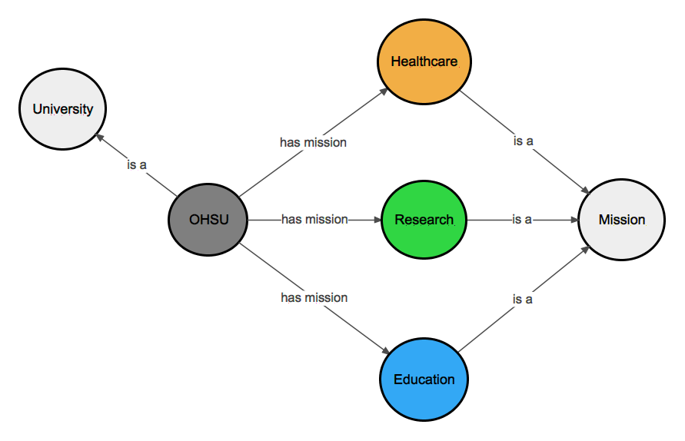
What's an ontology?
Model of a domain of knowledge
Concepts connected by relationships
They make a graph
Concepts are nodes
Relationships are edges
Described by triples
subject, predicate, object
University isA Concept
Mission isA Concept
hasMission isA Relationship
OHSU isA University
Healthcare isA Mission
Research isA Mission
Education isA Mission
OHSU hasMission Healthcare
OHSU hasMission Research
OHSU hasMission Education
Very tiny ontology!
Very tiny dataset!

Slide 5
Ontologies and...

Slide 6
Ontologies and... Metadata
Ontologies are Semantic Metadata
Globally unique identifiers in the form of URIs <http://data.ohsu.edu/entity/53e86b89-98b6-5b8e-8b44-ab36e21851fa> <http://www.w3.org/1999/02/22-rdf-syntax-ns#type> <http://schema.org/MedicalClinic> .
This is the Resource Description Framework (RDF)
Always know what entity we're referring to in any context
RDF + URIs = Linked Data
Organize entities by their relationship to each other
Interconnectedness
Places descriptive/structural/administrative metadata in context
Designed for sharing and reuse
Semantic Web

Slide 7
Ontologies and... Controlled Vocabularies
Any closed, prescribed list of terms
Typically no definitions
No relationships between terms
Most basic form is a simple list
Wine CV:
Pinot noir
Red
Chardonnay
Chianti
Bordeaux
Riesling
The above are different types:
Color
Location
Varietal

Slide 8
Ontologies and... Taxonomies
Any Controlled Vocabulary that is arranged in a hierarchy
Typically no definitions
No relationships between terms
Arranged in a hierarchy
Wine Taxonomy:
Red
Merlot
Zinfandel
Cabernet
Pinot Noir
White
Chardonnay
Pino Gris
Riesling

Slide 9
Ontologies and... Thesauri
A taxonomy with additional information about how to use terms and relationships between terms
May have definitions and/or scope notes
Terms may be related to each other
Arranged in a hierarchy
Example Thesauri:
MeSH
CINAHL Subject Headings
NCI Thesaurus

Slide 10
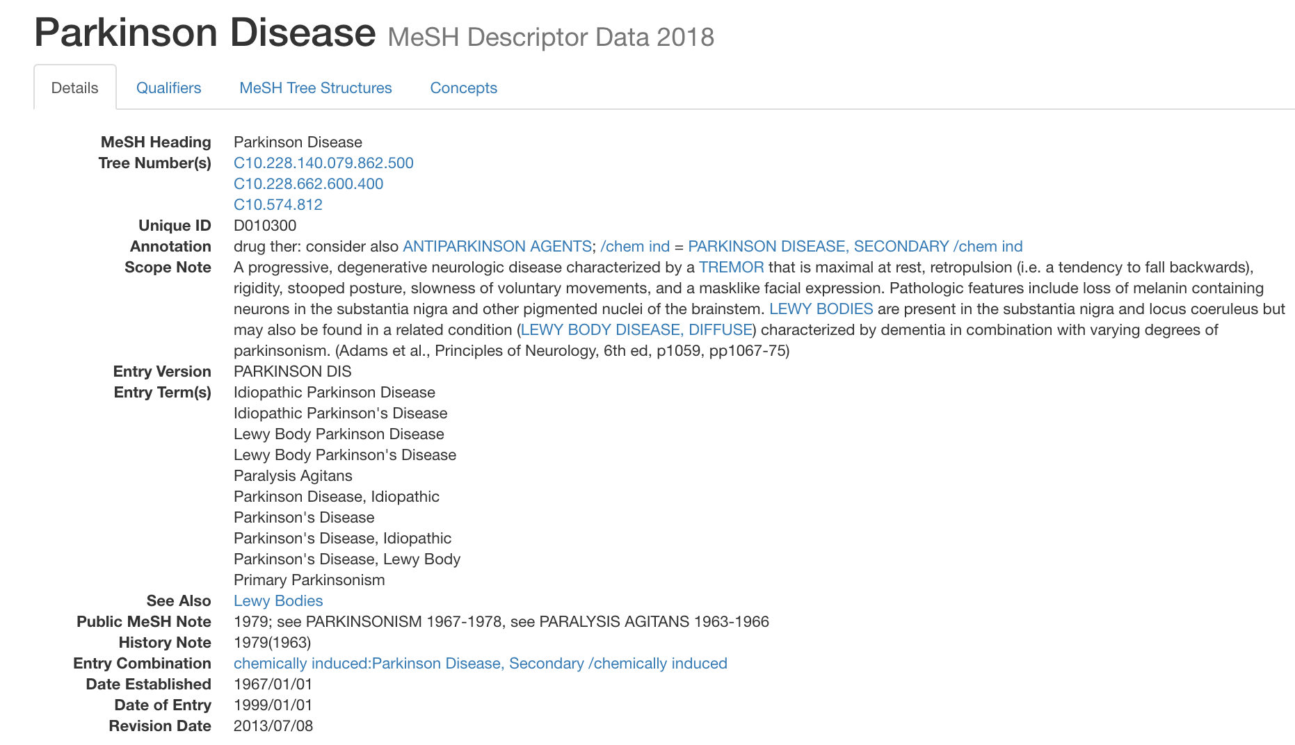
MeSH

Slide 11
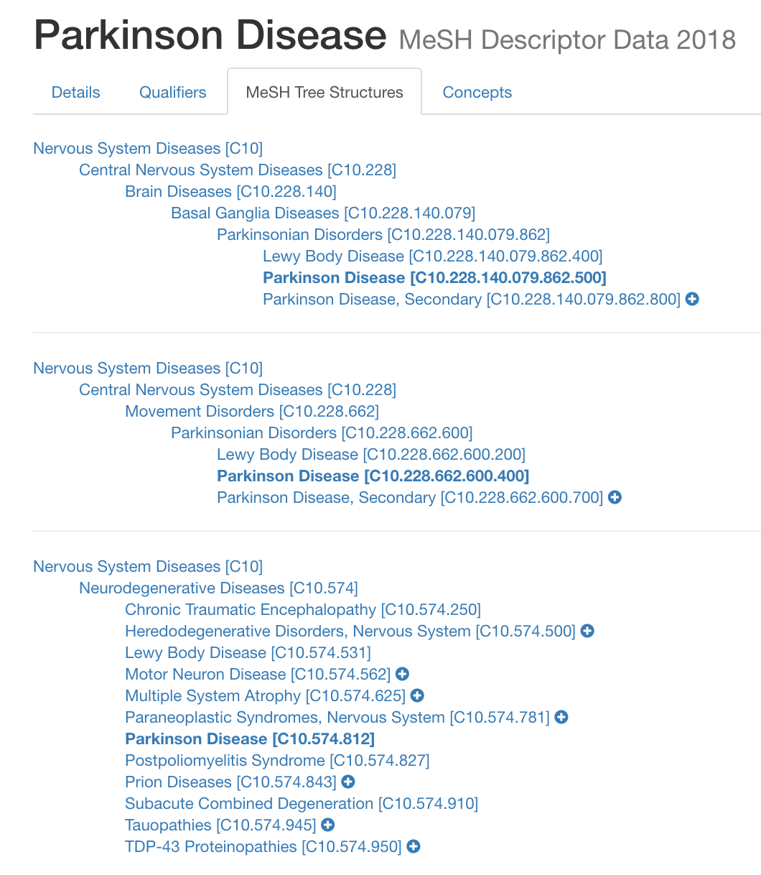
MeSH

Slide 12
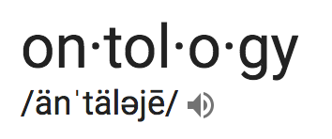
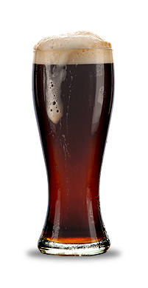

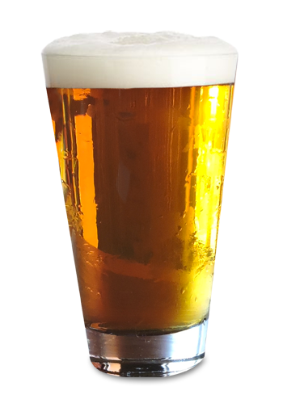
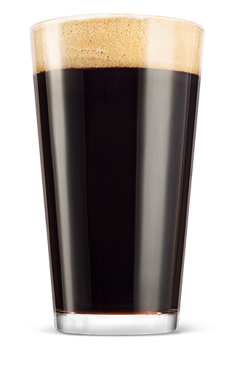


What's an ontology?
Beer
is_a
is_a
A knowledge classification of a domain, where the relationships between concepts are formally defined and logically related, which allows for computational reasoning
Key Features:
Terms are defined
Semantics - relationships between terms are defined, allowing logical inference and sophisticated data queries
Terms are arranged in a hierarchy
Expressed in a knowledge representation language such as RDFS, OBO, or OWL
Light beer
Dark beer
is_a
is_a
is_a
is_a
Pilsner
Lager
Porter
Stout

Slide 13
Ontologies and... Controlled Vocabularies
Taxonomy
Thesaurus
Ontology
Ambiguity control
Synonym control
Hierarchical relationships
Ambiguity control
Synonym control (U/UF)
Hierarchical relationships (BT/NT)
Associative relationships (RT)
Ambiguity control
Synonym control
Formal hierarchical relationships
Semantic associative relationships
List
Ambiguity control

Slide 14
Ontologies and... Relational Databases
Ontology | Database
Shared Understanding of Meaning | Data
Interoperability, Search, Communication | Efficient storage and querying of data
Strong focus on formal semantics | Minimal focus on formal semantics
Taxonomies form backbone | No taxonomies
Designed for reuse | Schemas rarely reused
Designed to evolve and change | Schemas difficult to evolve and change
Schema elements can be described just like data, which gives them meaning and allows inference of implicit info | Schemas have no description, no meaning, and do not support inference
Joins in the graph (courtesy of URIs) | Joins happen at query time

Slide 15
Ontologies and... Relational Databases
Bird table in a RDB
Bird ontology and data
Bird isA Animal
Bird hasPart Wing
Bird hasPart Beak
Bird hasPart Feather
Bird hasQuality WarmBlooded
Bird reproducesVia HardShellEgg
AmRobin isA Bird
AmRobin hasLocation NorthAmerica
AmRobin hasColor Brown
AmRobin hasColor Red
StellersJay isA Bird
StellersJay hasLocation WesternNorthAmerica
StellersJay hasColor Blue
StellersJay hasColor Black
Name | Location | Colors
American Robin | North America | Brown, Red
Steller's Jay | Western North America | Blue, Black

Slide 16
Inferencing implicit data
Asserted Triples
Inferred Triples
Bird isA Animal
Bird hasPart Wing
Bird hasPart Beak
Bird hasPart Feather
Bird hasQuality WarmBlooded
Bird reproducesVia HardShellEgg
AmRobin isA Bird
AmRobin hasLocation NorthAmerica
AmRobin hasColor Brown
AmRobin hasColor Red
StellersJay isA Bird
StellersJay hasLocation WesternNorthAmerica
StellersJay hasColor Blue
StellersJay hasColor Black
AmRobin isA Animal
AmRobin hasPart Wing
AmRobin hasPart Beak
AmRobin hasPart Feather
AmRobin hasQuality WarmBlooded
AmRobin reproducesVia HardShellEgg
StellersJay isA Animal
StellersJay hasPart Wing
StellersJay hasPart Beak
StellersJay hasPart Feather
StellersJay hasQuality WarmBlooded
StellersJay reproducesVia HardShellEgg

Slide 17
Why use an ontology?
When you want a shared understanding of your data so it can be reused by others
When you need your model and data to gracefully incorporate changes
When your data is highly connected
When your data is sparsely populated
When you want to discover implicit relationships in your data and derive new information from existing information
When you want different systems to communicate with each other and make novel connections to other linked data
When you want to publish your data on the web
When you need to reconcile your mental model with everyone else's

Slide 18

Can you name some ontologies?

Slide 19

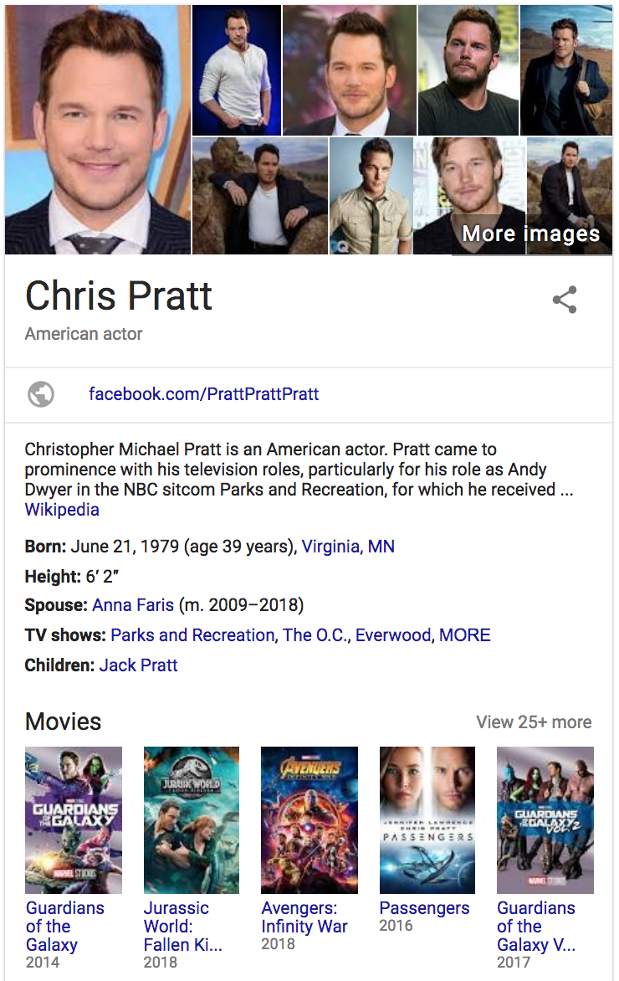
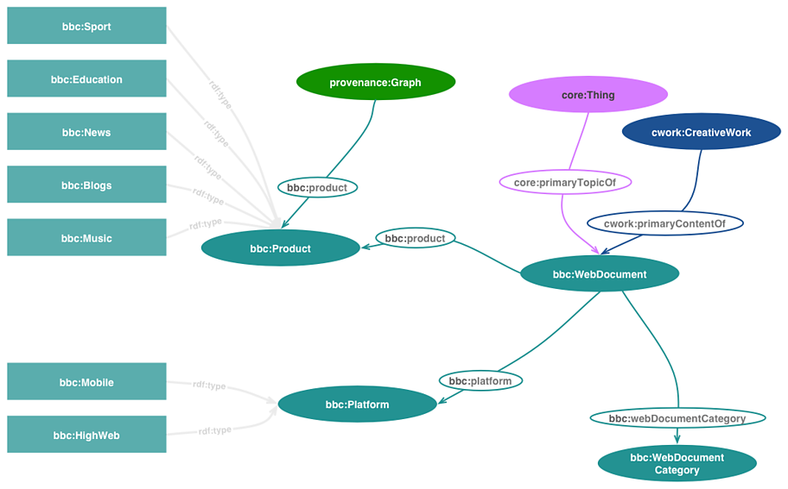
Ontologies in everyday life
https://www.bbc.co.uk/ontologies
Notes:
Wikidata

Slide 20
Who creates ontologies?
YOU
Engineers
Scientists
Computer Scientists
Philosophers
Mathematicians
Librarians

Slide 21
OBO Tutorial (modified for BDC)
Example data: histology assays of mice and rats
Follow along or go at your own pace:
https://ohsu-library.github.io/obo-tutorial
Download, clone, or fork the repository:
https://github.com/OHSU-Library/obo-tutorial
Optional tools to install:
obo-tutorial.jar (place in the examples directory)
Protégé
ROBOT
Notes:
In this tutorial we use a running example: histology assays of mice and rats. The example is small and fictional but it’s based on real datasets. Biology and biomedicine are vast fields, and this example won’t be a close fit to every reader’s field of research. The advantage is that the running example keeps the tutorial concrete and practical. Once you learn the various techniques for working with this example data, hopefully you’ll see how you can apply the same techniques to your work in your own field.
Open the first link in a browser and follow along
If you're Git-inclined, you can download or clone the repository at the second link, but this is entirely optional
I am going to walk through the tutorial, but it's designed to be self-paced, so feel free to ignore me and read ahead yourselves.
You can choose how deeply to engage with this material – the repository includes fully worked examples, so you can learn by observing, or you can dig in and learn by doing. You will need the optional tools to do this.

Slide 22
What information does this data contain?
datetime | investigator | subject | species | strain | sex | group | protocol | organ | disease | qualifier | comment
1/1/14 10:21 AM | JAO | 12 | RAT | F 344/N | FEMALE | 1 | HISTOPATHOLOGY | LUNG | ADENOCARCINOMA | SEVERE
1/1/14 10:30 AM | JAO | 31 | MOUSE | B6C3F1 | MALE | 2 | HISTOPATHOLOGY | NOSE | INFLAMMATION | MILD
1/1/14 10:45 AM | JAO | 45 | RAT | F 344/N | MALE | 1 | HISTOPATHOLOGY | ADRENAL CORTEX | NECROSIS | MODERATE
Each row is an observation made by an investigator of a study subject.
What does each column mean?
What about the values?
What does "B6C3F1" mean?
Does "histology" mean a general type of assay or a specific protocol for this study?
Are the date formats MMDDYY or DDMMYY?
Notes:
Take a look at the data-before.csv file. It’s just a spreadsheet in comma-separated-values format. What information does it contain? It’s hard to say without some context.
Each row of the spreadsheet describes an “observation” made by an investigator of a study subject – a mouse or a rat. The columns divide the information up into different fields. What does each column mean? Lab computers are stuffed with spreadsheets that have cryptic headers, or even lacking any headers. Those spreadsheets hang around long after the memory of what the columns mean has faded. Columns can become strange mixtures of special cases, especially when data about different sorts of things gets crammed into the same table. Some people may choose to ignore the headers and instead try to generalize from the values in the column instead.
What about the values? These are often more cryptic than the headers. What does “B6C3F1” mean? Worse, familiar names can be very misleading. Does “histology” mean a general type of assay or a specific protocol for this study? Many common date formats are completely frustrating: do they mean “MM/DD/YY” or “DD/MM/YY”?

Slide 23
What information does this data contain?
Meanings are clear to the investigators during study design and data collection
May not be clear to:
Other researchers in the same lab
Researchers in other labs
Original study authors at some time in the future
Solution:
Be clear from the outset
Bonus:
Communicating in a machine-readable way makes data easier to search and analyze
Notes:
During the study, as it’s being designed and the data is being collected, the meanings of the columns and the values will be clear to the investigators – more or less. The problem is communicating this information: to other researchers in the same lab, to researchers in other labs, and even to the original study authors at some time in the future. The solution to the communication problem is to be clear from the outset. If we are are clear enough in communicating to each other, we will also be able to communicate more clearly to our machines, resulting in better search and analysis.

Slide 24
What information does this data contain?
datetime | investigator | subject | species | strain | sex | group | protocol | organ | disease | qualifier | comment
1/1/14 10:21 AM | JAO | 12 | RAT | F 344/N | FEMALE | 1 | HISTOPATHOLOGY | LUNG | ADENOCARCINOMA | SEVERE
1/1/14 10:30 AM | JAO | 31 | MOUSE | B6C3F1 | MALE | 2 | HISTOPATHOLOGY | NOSE | INFLAMMATION | MILD
1/1/14 10:45 AM | JAO | 45 | RAT | F 344/N | MALE | 1 | HISTOPATHOLOGY | ADRENAL CORTEX | NECROSIS | MODERATE
datetime: when the observation was made
investigator: the initials of the person who made the observation
subject: the identifier of the subject that was observed
species: the name of the species of the subject
strain: the name of the genetic variant that the subject belongs to
sex: the biological sex of the subject
group: the identifier of the group that the subject is assigned to in the study
protocol: the name of the protocol used for the observation
organ: the name of the subject’s organ that was observed
morphology: the name of the disease or other abnormal state of the organ
qualifier: a keyword to further describe the morphology
comment: unstructured notes made by the investigator about the observation

Slide 25
How can we make it better?
Column | Current Format | Better Format | Technique
datetime | idiosyncratic date string | ISO standard | parse/replace
investigator | investigator initials | ORCID | replace
subject | string | application ontology IRI | rename
species | English, mixed case | NCBITaxon IRI | MIREOT
strain | string | application ontology IRI | Define New
sex | English, mixed case | PATO IRI | MIREOT
group | string | application ontology IRI | rename
protocol | ambiguous string | OBI IRI | MIREOT
organ | English, mixed case | Uberon IRI | extract
disease | English, mixed case | MPATH IRI | MIREOT
qualifier | English, mixed case | PATO IRI | MIREOT
comment | English unstructured text | – | keep
Notes:
Now we’ll make a table with a row for each of these.
describe the current format of the cells
suggest a better format
name a technique for converting the current format to the new format.
We’ll see more about each of these techniques in the coming sections.

Slide 26
About those acronyms…
an IRI is an Internationalized Resource Identifier for naming things such as people, studies, study subjects, classes of things, relations between thing, and anything else we care to give a name to
an ORCID is a special IRI for a researcher
an application ontology is a collection of ontology terms for a particular purpose; we’ll use terms from these reference ontologies:
NCBITaxon is a translation of the NCBI Taxonomy
PATO is the Phenotypic Quality Ontology
OBI is the Ontology for Biomedical Investigations
Uberon is an integrated cross-species ontology
MPATH is the Mouse Pathology Ontology
Notes:
Some of the acronyms might not yet be familiar:
an IRI is an Internationalized Resource Identifier for naming things such as people, studies, study subjects, classes of things, relations between thing, and anything else we care to give a name to
an ORCID is a special IRI for a researcher
an application ontology is a collection of ontology terms for a particular purpose; we’ll use terms from these reference ontologies:
NCBITaxon is a translation of the NCBI Taxonomy
PATO is the Phenotypic Quality Ontology
OBI is the Ontology for Biomedical Investigations
Uberon is an integrated cross-species ontology
MPATH is the Mouse Pathology Ontology

Slide 27
A preview of our Better BioData!
datetime | investigator | subject | species | strain | sex | group | protocol | organ | disease | qualifier | comment
2014-01-01T10:21:00-0500 | http://orcid.org/0000-0001-5139-5557 | tutorial:subject-12 | obo:NCBITaxon_10116 | tutorial:F344N | obo:PATO_0000383 | tutorial:group-1 | obo:OBI_0600020 | obo:UBERON_0002048 | obo:MPATH_268 | obo:PATO_0000396
2014-01-01T10:30:00-0500 | http://orcid.org/0000-0001-5139-5557 | tutorial:subject-31 | obo:NCBITaxon_10090 | tutorial:B6C3F1 | obo:PATO_0000384 | tutorial:group-2 | obo:OBI_0600020 | obo:UBERON_0007827 | obo:MPATH_212 | obo:PATO_0000394
2014-01-01T10:45:00-0500 | http://orcid.org/0000-0001-5139-5557 | tutorial:subject-45 | obo:NCBITaxon_10116 | tutorial:F344N | obo:PATO_0000384 | tutorial:group-1 | obo:OBI_0600020 | obo:UBERON_0001235 | obo:MPATH_4 | obo:PATO_0000395
Notes:
Note: This is the last part of the first section of the tutorial.

Slide 28
Names and Naming
Why do people use terse, ambiguous, cryptic names for things?
Save time and effort
Short names fit better
Memory and storage were once scarce
Notes:
The data-before.csv file contains terse, ambiguous, and misleading names. This isn’t unusual! How can we be be more explicit and communicate more clearly? The fist step is to use better names.
Why do people use terse, ambiguous, cryptic names for things? There are many reasons. In our day-to-day language we tend to use short names and abbreviations to save time and effort, relying on context to remove ambiguity. Unfortunately, context can fade with time and distance. There are also practical limitations: short names fit better into dense columns, and memory and storage were precious on legacy computer systems. But today storage is cheap, and better software can autocomplete values and display short names while storing longer, unambiguous names.

Slide 29
A technology for practically unlimited unambiguous names
<https://github.com/OHSU-Library/obo-tutorial/>
This is a Uniform Resource Locator (URL)
It’s a building block of the World Wide Web
It has three main parts:
The protocol (https)
The host (github.com)
The path (OHSU-Library/obo-tutorial)
Notes:
The protocol tells you how to get the resource. Common protocols for web pages are http (HyperText Transfer Protocol) and https (HTTP Secure). The host is the name of the server to contact, which can be a numeric IP address, but is more often a domain name. The path is the name of the resource on that server.

Slide 30
What's so great about URLs?
Consistent enough to be shared across the world
Standardized protocols (HTTP, DNS, IP addresses)
Allocated to organizations and people
Path can be almost anything
Almost anyone can make their own
Flexible enough to provide a practically unlimited number of globally unique names
Our study
Each subject
Each observation/row
Relationships expressed by columns
Reused values
Notes:
URLs combine three very important features: they’re consistent enough to be shared across the world, almost anyone can make their own, but they’re flexible enough to provide a practically unlimited number of names. The consistency comes from (1) the standardized protocols, such as HTTP. DNS names and IP addresses (2) are allocated to organizations and people, and there’s a lot of them, allowing almost anyone to have their own “namespace”. Between (1) and (2) we have standard ways to find the server that hosts that namespace and connect to it across the Internet. And within each namespace, the path (3) can be almost anything, allowing for each namespace to contain a vast number of names.
What can we do with all these names? We can give a globally unique name to anything we care to talk about. We can give our study a globally unique name. We can name each subject in our study. We can name each row of our table of data (each observation). We can name the relationships that our columns express. We can give a name to the values that we reuse. We don’t have to assign a name to everything, but we have more than enough names for everything that we want to name.

Slide 31
More standards for names
Universal Resource Name (URN)
Universal Resource Identifier (URI)
Either a URL or a URN
ASCII only
Internationalized Resource Identifier (IRI)
Unicode capable
This is the term we'll use for the tutorial
Most of the examples are URLs
Notes:
There’s actually a family of related standards for these names. Related to the URL is the URN (Universal Resource Name) which has a somewhat different structure. A URI(Universal Resource Identifier) is either a URL or a URN. URIs are limited to ASCIIcharacters (for the English alphabet), but an IRI (Internationalized Resource Identifier) can have Unicode characters (for almost every language). Because “IRI” is the most general term, that’s the one I’ll use in what follows, but pretty much every example mentioned is just a humble URL.

Slide 32
Compact Names
Compact URI (CURIE)
A prefix that stands in for a longer base IRI
A suffix (a reference to an ontology term)
Expand prefix + append suffix = full IRI
obo: http://purl.obolibrary.org/obo
obo:OBI_0000070 expands to http://purl.obolibrary.org/obo/OBI_0000070
Documents that use CURIEs need to define the prefixes

Slide 33
Common Prefixes
Prefix | IRI | Name
rdf | http://www.w3.org/1999/02/22-rdf-syntax-ns# | Resource Description Framework
rdfs | http:/www.w3.org/2000/01/rdf-schema# | RDF Schema 1.1
xsd | http://www.w3.org/2001/XMLSchema# | XML Schema
owl | http://www.w3.org/2002/07/owl# | Web Ontology Language
obo | http://purl.obolibrary.org/obo/ | Open Biological and Biomedical Ontologies
Notes:
Here are some very common prefixes for our work

Slide 34
OBO Names
OBI:0000070 (assay)
ID Space
Local ID
http://purl.obolibrary.org/obo/OBI_0000070
Notes:
OBO has its own policy for naming terms that’s worth discussing now. Every OBO ontology has its own “ID space”, which is a string of a few letters, e.g. “OBI” for the Ontology for Biomedical Investigations. Every term has a unique “Local ID”, which is a string of digits, e.g. “0000070” for OBI’s “assay” term. The combination is the term’s identifier, e.g. “OBI:0000070”. This is what we mean by the ID of an OBO term. Add the http://purl.obolibrary.org/obo/ prefix (and use an underscore) and you get the term’s unique IRI: http://purl.obolibrary.org/obo/OBI_0000070.

Slide 35
Why numeric IDs?
Cons:
Terms are opaque and carry no meaning for humans
Requires software tools that can reveal meaning
Pros:
Easy to replace terms with better terms
New term gets new ID, encourages use
Old term keeps its ID, supports legacy data
Makes versioning easier
Trivial for software to translate to something human-readable
Notes:
Using numeric IDs for terms has advantages and disadvantages. The biggest and most obvious disadvantage is that the term ID is opaque: it carries no meaning for a human reader. There’s nothing about the ID that tells you that it’s the ID for “assay” – at this point I’ve just memorized that association. But the opacity of the ID becomes an advantage if we ever have to replace the OBI “assay” term with a better term. The new “assay” term will get a new ID and the old term can keep its ID to support legacy data – we try our best not to break legacy systems! If the term ID were not opaque but used a meaningful word, something like “OBI_assay”, what would we call the new term? “OBI_assay_new”? And what if we had to replace it, in turn? “OBI_assay_new_2”? My bet is that people would keep using the old “OBI_assay” ID just because it looks right, and never update to the improved terms.
Opaque IDs make versioning easier, and versioning is crucial. We can overcome the disadvantages of opacity with better tools. It’s trivial for software to go from a unique ID to a human-readable label. But trying to go from an ambiguous, human-readable label to a unique ID required a carefully specified context, or else it becomes a recipe for disaster. Better to use globally unique IRIs and improve our tools.

Slide 36
One more acronym
PURL
Persistent URL
A URL that is expected to always point to the same resource
Typically implemented as a redirect
Resources can move
PURL remains the same
Notes:
One other acronym you might come across is “PURL” (Persistent URL). A PURL is just a URL, but with additional expectations that it will always point to the same resource. PURLs usually work by transparently redirecting a request to another address. If a resource is moved to a new server, for example, the PURL doesn’t change, but it will redirect you to the new address instead of the old one. (In general, cool URIs don’t change, and every IRI should be persistent, but people use PURLs to make their intentions clear.)
It’s important to know that there are some differences, but for pretty much all our purposes we can treat these as the same: URL, URI, IRI, and PURL for full names; CURIE or OBO term ID for abbreviations. I’ll try to stick to “IRI”.

Slide 37
How many names?
We can assign as many names as we want
How many do we want?
It's better when things have only one name
Coordinating names can be challenging
Notes:
IRIs let us assign as many names as we want. But it’s important to step back and ask: how many names do we want?
Names are most useful when everything that we want to talk about has only one name. When you and I both use the same name for the same thing, then we’re communicating. If we use different names for the same thing, then it takes extra work to figure out that we both mean the same thing.
Coordinating names can be a challenge. The challenge only increases when the community of communicators is large, and our knowledge of the things we’re talking about is changing quickly. I’m sure you’ll recognize this situation in your field of research: new terminology is introduced, revised and revised again to fit new facts and usage, and then perhaps settles into some stable textbook meaning or disappears all together.
(This is the last slide for the Names section.)

Slide 38
OBO Ontologies
Ontologies provide systems of names
Open Biological and Biomedical Ontologies (OBO)
A community of ontology projects for science
Shared principles and practices
Standardized names for general concepts within a scientific domain
obo:OBI_0000070 is the class of all assays (general, universal)
Observations in the data are particular assays that happened at certain places and times
Notes:
One of the things that ontologies do is provide systems of names. The Open Biological and Biomedical Ontologies (OBO) is a community of ontology projects for science with shared principles and practises. Most OBO ontologies provide standardized names for the things that are general within a scientific domain. The term obo:OBI_0000070 is an example: it names the class of all assays in general. The observation described in the first row of data-before.csv is a particular assay that happened at a certain place and time. The class of all assays is general (or universal) – it does not exist in space and time, but we can give it a name and talk about it.
(It’s a little redundant to say “an OBO ontology” – “an Open Biological and Biomedical Ontologies ontology” – but for our purposes it means “an ontology that belongs to the OBO Library and follows OBO principles”.)

Slide 39
Reference vs. Application Ontologies
Reference Ontologies
Serve a general purpose
Provide terms for some domain of science
Like a textbook or a dictionary
Focus on universals
Application Ontologies
Serve a specific purpose
Limited to a particular project or institution
Cross several domains
Include terms from more than one reference ontology
Focus on particulars
OBO Ontologies are reference ontologies
Notes:
We should distinguish between reference ontologies and application ontologies. A reference ontology is meant to serve a general purpose, providing terms for some domain of science. We can compare it to a textbook or a dictionary. An application ontology is meant to serve a specific purpose, limited to a particular project or institution, but often crossing several domains. An application ontology is likely to include terms from several reference ontologies. Reference ontologies focus almost exclusively on universals, while application ontologies are more likely to include terms for particulars.
OBO ontologies are reference ontologies – they focus on terms for the universals within a scientific domain. In our running example we will be using terms from several reference ontologies, such as Uberon and OBI. In this tutorial we will be building an application ontology to support our running example, importing these reference ontology terms and adding other terms that don’t exist in (or belong in) any reference ontology.

Slide 40
Using and Reusing Ontology Terms
IRIs give us all the globally unique names we need
Ontologies give us systems of standardized names
Using an OBO reference ontology means using its IRI in your data
Every term should have just one IRI
Don't make up your own
Use the official one!
We're going to try these techniques by building an application ontology to support the example data
Notes:
IRIs give us all the globally unique names that we need. Ontologies give us systems of standardized names (and more). Now let’s see how to use them.
“Using” an OBO reference ontology term means using its IRI in your data. Every term should have just one IRI – don’t make up your own name for it, use the official one! In this section you’ll learn how to find the terms you want, how to assess whether they’re high-quality, and how to import them into the application ontology for your project. We’ll illustrate these techniques by building an application ontology to support our running example.

Slide 41
Finding Ontologies and Terms
Ontobee http://www.ontobee.org/
BioPortal https://bioportal.bioontology.org/
Ontology Lookup Service https://www.ebi.ac.uk/ols
Linked Open Vocabularies http://lov.okfn.org
OntoMaton https://github.com/ISA-tools/OntoMaton
OBO Foundry http://obofoundry.org/
GitHub https://github.com
Notes:
OBO ontologies are freely distributed, and there's a number of different web sites that you can use to find them. We usually begin by searching for an appropriate label, and then check to make sure that the textual and logical definitions fit what we need.
Ontobee
Ontobee lists all the OBO ontologies and provides useful search and analysis tools. Many OBO projects use it as the endpoint for their PURLS -- if you click http://purl.obolibrary.org/obo/OBI_0000070 you'll be taken to the Ontobee page for OBI's "assay" term. Ontobee also provides information on how each term is used in other OBO ontologies. Ontobee term pages provide RDF/OWL data that can be used by software. I use Ontobee all the time for finding OBO terms, either within an ontology that I know or across all the OBO projects.
BioPortal
BioPortal provides access to OBO ontologies and many more ontologies and terminologies for biology and medicine. If you can't find the term you're looking for using Ontobee, maybe you can find it using BioPortal. If the term you want belongs to an ontology that is not part of OBO, you might still be able to use it. See the section below on assessing ontologies for reuse.
Ontology Lookup Service (OLS)
The Ontology Lookup Service (OLS) is a repository for biomedical ontologies that aims to provide a single point of access to the latest ontology versions. You can browse the ontologies through the website as well as programmatically via the OLS API. OLS is developed and maintained by the Samples, Phenotypes and Ontologies Team (SPOT) at the European Bioinformatics Institute (EMBL-EBI).
Linked Open Vocabularies (LOV)
Linked Open Vocabularies (LOV) is a repository for ontologies on the web. If you need a concept from an ontology outside the domain of biomedicine, this is a good place to look. Originally hosted by the Open Knowledge Foundation, it is now maintained by the Ontology Engineering Group (OEG) at the Computer Science School at Universidad Politécnica de Madrid (UPM).
OntoMaton
OntoMaton is a useful plugin for Google Spreadsheets. It uses BioPortal to find and autocomplete terms in selected columns of your sheet. You can also configure it to use only the ontologies you prefer, such as only OBO ontologies. Restrict to the smallest set of ontologies you can to improve search speed. Use the term links to check their definitions! When I have a list of terms I want to map, it's often fastest to setup a new Google spreadsheet with OntoMaton configured to the ontologies I want to use.
Other places to find ontologies
Ontobee lists all the OBO ontologies and a few more, but the official list is at the OBO home page: http://obofoundry.org. That list distinguishes between "OBO Foundry" ontologies that have been reviewed for their adherence to the OBO Foundry principles, and "OBO Library" ontologies that have made a commitment to the principles but have not been reviewed. For each entry there's a brief description of the domain, plus links to information pages and ontology files.
Several of the OBO principles and best practises are based on open source software development best practises. These include keeping files in publicly accessible version control systems that track and store every change to the ontology. Most OBO projects use one of these websites for hosting project files in version control:
GitHub
SourceForge

Slide 42
Working with found ontologies
Most ontologies are distributed as OWL files
OWL is the Web Ontology Language
Builds upon RDF and RDF Schema (RDFS)
OWL and RDFS include concepts that facilitate inference
OWL files can be downloaded so you can work with them on your computer
Protégé is an open-source, cross-platform ontology editor
Convert to Turtle (a human-readable/writeable RDF format) and edit by hand in a text editor
Notes:
Now that you've found all these ontologies, what are you getting and how do you work with them?
OBO projects use the Web Ontology Language (OWL) and are distributed in OWL files. You can use the Ontobee and BioPortal websites to browse ontologies, but if you want to download the OWL file and work with it on your computer then you probably want to use Protégé. Protégé is free, open source, and cross-platform.

Slide 43
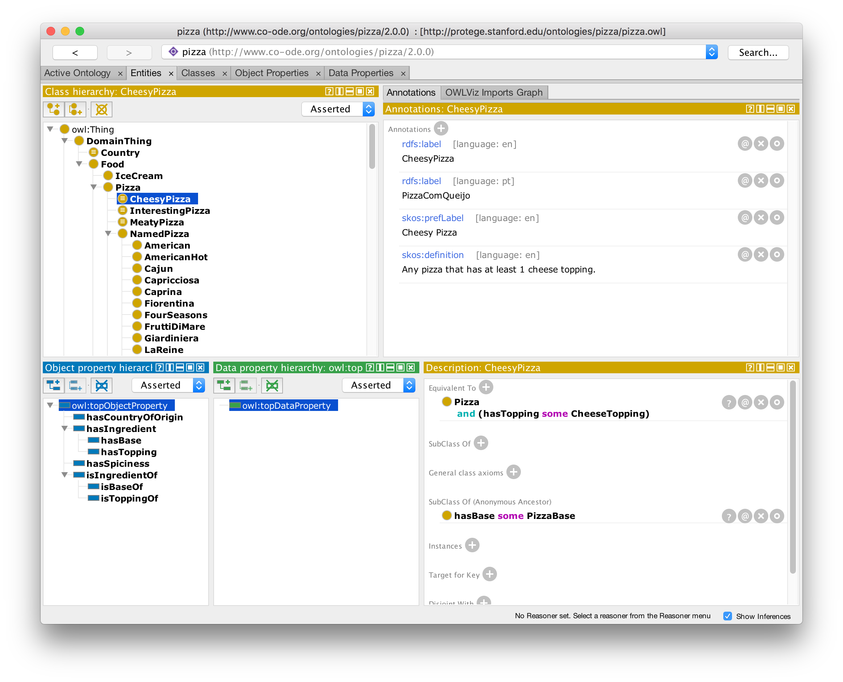

Slide 44
Assessing for reuse
License
PURLs
Labels
Textual Definitions
Logical Definitions
Term Status
Community
Has curation status:
Ready for release
Pending final vetting
Metadata complete
Metadata incomplete
Requires discussion
Organizational term
To be replaced with external ontology term
Example to be eventually removed
Uncurated
Notes:
Assessing Ontologies and Terms for Reuse
Once you find a term that might be suitable, there are some things that you should check before you start using it. The OBO principles are intended to cover all these points, so when using a term from an OBO ontology it should be quick to check all these boxes. With projects outside the OBO community you will have to check more carefully.
License
The first question is: can I use this term in my application ontology? This raises a series of questions about copyright.
OBO ontologies are intended to be shared and required to be open, in the sense of "open source". The Creative Commons CC-by 3.0 license is recommended for OBO projects, although there's some variation. We expect people who use OBO ontology terms to use the official IRI for that term. We also expect users to respect common standards in the scientific community for giving credit to ontology developers for their work, such as citing the ontology in your publications. (Most ontologies have a "release paper" in a journal that you can use for citations. Check the ontology's website.)
PURLs
Every term should have a single, official IRI that identifies it, often called a "PURL". When you put that IRI into a web browser you should be directed to a useful webpage or file. Even IRIs for obsolete terms should continue to point to something useful. If the term you want to use doesn't have a reliable, permanent identifier, than how can you be sure that you and the rest of the community are using the same term?
There is an OBO principle for unique identifiers and a identifier policy with the technical details.
Labels
Every term should have a single, official label. It can have many synonyms, translations, and alternative terms, but there should be a just one official label. It should probably be in American English. Ideally, it will be unambiguous across all of biology and biomedicine, and avoid ambiguities with common words in English. It shouldn't contain jargon or acronyms. Taking all of this into account, many ontology labels are long and ugly, but at least they're clear. You can always add a shorter synonym or alternative term.
Labels are important, but the definition is even more important, so don't stop at reading the label!
OBO ontology terms all have an rdfs:label value. Some OBO ontologies use the IAO editor preferred term annotation to store the unique label, so that the rdfs:label can be changed to an alternative term suitable for particular use cases. There are also naming conventions for OBO terms, and an IAO ontology metadata page.
Textual Definitions
Does the term have a textual definition?
There's a surprising number of "ontologies" out there with terms that have IRIs and labels but no textual definitions at all. There's a simple reason for that: good textual definitions are hard to write! And when you've written a clear and concise textual definition of 'X', more often than not you'll find that your collaborators say "That's not how we use 'X'". It's not until you have a definition that you can really start to discuss the meaning of a term, and build some consensus. Without a good definition it's hard to be sure that everyone understands the term in the same way.
For our current purposes, an "annotation" is a bit of data attached to a term that doesn't have logical structure -- we'll talk about logic in just a second. Labels and textual definitions are the most important annotations, but terms are even more valuable when they have examples of usage, synonyms and alternative terms, editor names and editor notes. If a term looks promising, read all of its annotations.
Logical Definitions
Does the term have a logical definition?
With few exceptions, every term should have a parent term. OBO ontologies usually extend the Basic Formal Ontology (BFO) which has just one term without a parent: "entity".
Most ontologies use the Web Ontology Language, which provides a range of powerful tools for make logical statements about terms and their relationships. Well-defined logical relations allow for automated reasoning over the ontology and the data that uses it. The richer the logical definitions, the more work the reasoner can do, although there's a balance to strike between power and performance.
If the term you want to use fits into the upper ontology and other relations that you're already using, then you're enriching the network of data in your application ontology. If the term doesn't fit, then you might not be adding much by using it. OBO ontologies strive to form a rich, interconnected network.
Term Status
Terms have a "life cycle", starting with their creation and ending with their obsolescence. You should check the status of a term before using it.
Terms that should no longer be used are marked as obsolete using the OWL deprecated annotation, and a reason may be given using the IAO has obsolescence reason annotation. The word "obsolete" is usually added to the label as a further warning. An obsolete term should not be used for new data! However it is best practise to maintain obsolete terms indefinitely at the same IRI to support old data. If a term you want to use is marked obsolete, check the annotations for a preferred replacement.
Many OBO terms are annotated with IAO has curation status to indicate where the term is in its life cycle. A mature term is marked ready for release, and other statuses indicate how close the term is to maturity. You should prefer terms with status closer to the top of this list:
ready for release
pending final vetting
metadata complete
metadata incomplete
requires discussion
organizational term
to be replaced with external ontology term
example to be eventually removed
uncurated
Problems that are keeping a term from being "ready for release" are often explained in an editor note.
Community
Who made this ontology? When was it made? Has it been updated since its initial release? Is it ever going to be updated again?
Several related OBO principles require that an ontology have a community of users who collaborate on the ontology, some person or group or organization in charge, and a commitment to ongoing maintenance. Too often I've found an ontology that passes all the other criteria, but it was developed by a few authors to support a single project five years ago, and it hasn't been updated since. Building an ontology and maintaining it is hard. Building a community and maintaining it is even harder. But this is another thing that OBO projects strive to do.

Slide 45
Mapping Terms
datetime | investigator | subject | species | strain | sex | group | protocol | organ | disease | qualifier | comment
1/1/14 10:21 AM | JAO | 12 | RAT | F 344/N | FEMALE | 1 | HISTOPATHOLOGY | LUNG | ADENOCARCINOMA | SEVERE
1/1/14 10:30 AM | JAO | 31 | MOUSE | B6C3F1 | MALE | 2 | HISTOPATHOLOGY | NOSE | INFLAMMATION | MILD
1/1/14 10:45 AM | JAO | 45 | RAT | F 344/N | MALE | 1 | HISTOPATHOLOGY | ADRENAL CORTEX | NECROSIS | MODERATE
Make a list of local terms
Search for reference ontology terms
Decide how to import each term into your application ontology
Notes:
We’ve just seen how to find OBO ontologies and terms, and how to assess their quality. Now let’s put that into practise.
Starting with data like our data-before.csv spreadsheet, the first step is usually to create a list of all the “local” terms you want to “map” to reference ontology terms. You can put this list in a spreadsheet. Then I use Ontobee and OntoMaton to find one ontology term for each local term. Usually I can find one, with a little work, but sometimes I can’t. My third step is to decide how to get each term into my application ontology. There are four main techniques that I use, each described in the next section:
if there’s just a few terms from the reference ontology, I’ll MIREOT them using OntoFox
if I want to use many terms from a small reference ontology, I’ll import the whole thing using Protégé
if there are many terms from the reference ontology or the reference ontology has complex logical axioms, but I don’t want to import the whole thing, then I’ll extract the terms I need using OWLAPI
if there’s no reference ontology term, then I’ll define the term for my application ontology using QTT or in Protégé
So those are my three steps:
make a list of local terms
search for reference ontology terms
decide how to import each term into my application ontology
This Google spreadsheet shows the list of terms from data-before.csv, the reference ontology terms I want to map them too, and the import technique I will use. It also shows how you can use the OntoMaton plugin to make searching easier.
PAUSE HERE FOR 5-10 MINUTES AND LET PEOPLE SEARCH FOR TERMS ON THEIR OWN

Slide 46
Local Term Label | Ontology Term Label | Ontology Term IRI | CURIE | Technique
RAT | Rattus norvegicus | http://purl.obolibrary.org/obo/NCBITaxon_10116 | obo:NCBITaxon_10116 | MIREOT
MOUSE | Mus musculus | http://purl.obolibrary.org/obo/NCBITaxon_10090 | obo:NCBITaxon_10090 | MIREOT
F 344/N |  |  | tutorial:F344N | Define New
B6C3F1 |  |  | tutorial:B6C3F1 | Define New
FEMALE | female | http://purl.obolibrary.org/obo/PATO_0000383 | obo:PATO_0000383 | MIREOT
MALE | male | http://purl.obolibrary.org/obo/PATO_0000384 | obo:PATO_0000384 | MIREOT
HISTOPATHOLOGY | histology | http://purl.obolibrary.org/obo/OBI_0600020 | obo:OBI_0600020 | MIREOT
LUNG | lung | http://purl.obolibrary.org/obo/UBERON_0002048 | obo:UBERON_0002048 | EXTRACT
NOSE | external nose | http://purl.obolibrary.org/obo/UBERON_0007827 | obo:UBERON_0007827 | EXTRACT
ADRENAL CORTEX | adrenal cortex | http://purl.obolibrary.org/obo/UBERON_0001235 | obo:UBERON_0001235 | EXTRACT
ADENOCARCINOMA | adenocarcinoma | http://purl.obolibrary.org/obo/MPATH_268 | obo:MPATH_268 | MIREOT
INFLAMMATION | inflammation | http://purl.obolibrary.org/obo/MPATH_212 | obo:MPATH_212 | MIREOT
NECROSIS | necrosis | http://purl.obolibrary.org/obo/MPATH_4 | obo:MPATH_4 | MIREOT
SEVERE | severe intensity | http://purl.obolibrary.org/obo/PATO_0000396 | obo:PATO_0000396 | MIREOT
MILD | mild intensity | http://purl.obolibrary.org/obo/PATO_0000394 | obo:PATO_0000394 | MIREOT
MODERATE | moderate intensity | http://purl.obolibrary.org/obo/PATO_0000395 | obo:PATO_0000395 | MIREOT
JAO |  |  | http://orcid.org/0000-0001-5139-5557

Slide 47
Importing Terms: MIREOT
Minimum Information to Reference an External Ontology Term
A technique from the bioinformatics community/OBO for importing single terms
You can use it as a verb: "You should MIREOT that term into your ontology"
Don't have to include parent terms or logical definition
Be sure everything you say about your term is still true
Notes:
Importing Single Terms with MIREOT
Using an ontology term means using its IRI, but you will also want to keep its label, definition, and other annotations. MIREOT: The minimum information to reference an external ontology term is a guideline for what information to include when importing a term. We even use "MIREOT" as a verb: "You should MIREOT that term into your ontology."
When you MIREOT a term, you don't have to include its parent terms or logical axioms, but if you don't then you have to be careful. As an example, the term Homo sapiens is about 29 nodes deep in the NCBI Taxonomy. If you want to use that term, you probably don't want to import all its ancestors. But you do have to ensure that everything you say about that term is still true! You could place Homo sapiens under Mammalia in your application ontology, which would be true, even if it doesn't include all the information that's in the NCBI Taxonomy. Don't place it under the NCBI term Mus musculusbecause then your assertion would be false!

Slide 48
Importing sets of terms with OntoFox
http://ontofox.hegroup.org/
Free service for MIREOTing terms, but with limited resources
Many options for extracting parts of ontologies
Partial hierarchies
Annotations
Has additional configuration file-driven interface that allows selecting from multiple ontologies at once
Example input: ontofox.txt
Example output: ontofox.owl

Slide 49
Importing lists of terms with QTT and Ontorat
http://ontorat.hegroup.org/
Same family of tools as Ontobee and OntoFox
Uses a technique known as Quick Term Templates (QTT)
Fill out the form or upload a file
Example settings file: ontorat.txt
Example input data file: qtt.txt
Example output: ontorat.owl

Slide 50
Extracting Ontology Modules with ROBOT
http://robot.obolibrary.org/
ROBOT is like a Swiss Army Knife for ontology manipulation
Download Uberon from http://purl.obolibrary.org/obo/uberon/ext.owl
Run the ROBOT filter command robot filter \ --input ext.owl \ --term BFO:0000050 \ --term BFO:0000051 \ --output uberon-subset.owl
Run the ROBOT extract command robot extract --method STAR \ --input uberon-subset.owl \ --term-file uberon-terms.txt \ --output uberon-mod.owl

Slide 51
Extracting ontology modules with obo-tutorial.jar
cd examples
java -jar obo-tutorial.jar extract \
ext.owl \
uberon-terms.txt \
uberon-module.owl \
"https://github.com/OHSU-Library/obo-tutorial/raw/master/examples/uberon-module.owl"

Slide 52
Importing full ontologies
OWL supports importing full ontologies into your own
When MIREOT is not enough
For OntoFox/Ontorat/ROBOT outputs
For modular ontology designs
Can be imported with Protégé
Can be imported by hand with owl:imports annotation
Notes:
Importing Ontologies with Protégé
OBO ontologies are part of the web of linked data. Using terms from other ontologies means making links to resources across the web. Another form of linking is import: you can import another complete ontology or OWL file into your own ontology.
For our current purposes, there are two main uses for OWL imports. The first is when MIREOT just isn't enough: you don't want to import just a selection of terms from another ontology, you want to import the whole thing. The second is using the results of OntoFox and Ontorat. These tools generate OWL files. Using a configuration file, you can run these tools again and again to update terms, generating new OWL files each time. You should keep those results in separate OWL files, then import those files into your application ontology. This clean separation makes it easy to update your MIREOT and QTT imports.
Keep in mind that imports can be somewhat unpredictable. Tools such as Protégé will keep a local copy of imported files, which might not always be up-to-date. If you and your collaborators have different local copies of the imports, you won't see exactly the same terms and axioms, which can lead to all sorts of confusion!
OBO ontologies have versions, usually specified by date. I recommend importing a specific, dated version of any ontology. To update it, just change the import link to the latest dated version. This allows you to control when updates are made. And if the other ontology project releases a new version that breaks something in your ontology, you'll be able to stick to the older version until the problem is fixed.
For OntoFox or Ontorat OWL files, just use the latest OWL files. You control when you update those files, so there shouldn't be any problem with mismatching versions.

Slide 53
Putting it all together
Create a new ontology
Specify it's "Ontology IRI": https://github.com/OHSU-Library/obo-tutorial/raw/master/examples/application.owl
Import three tutorial example OWL files:
ontofox.owl
ontorat.owl
uberon-mod.owl
Make adjustments:
Add terms
Add annotations
Carefully adjust the hierarchy
Save to application.owl
Or skip all that and look at the finished application.owl file.
Notes:
First we saw how to find reference ontology terms and assess them. Then we saw how to create a "mapping" table for all our terms. And we just saw four techniques for importing reference ontology terms into our application ontology. The last step is to put all of this together and complete our application ontology.
Open a new ontology
Change its "Ontology IRI" to https://github.com/OHSU-Library/obo-tutorial/raw/master/examples/application.owl
Import three OWL files:
ontofox.owl
ontorat.owl
uberon-module.owl
Make adjustments: add terms, add annotations, carefully adjust the hierarchy
Save the ontology to application.owl
Or skip those steps and just look at the resulting application.owl file that I've created. The result includes all the terms listed in our terms.csv file, plus the dependencies that we want. I've also made adjustements to fit everything under BFO "entity" by adding subClassOf assertions here and there.
One application ontology can support many similar projects. In the next section we'll see how to connect the data in the running example to the application ontology to take full advantage of it.

Slide 54
Tables to Triples
Tables are hard to share
Tables are hard to merge
Graphs are more flexible
RDF is the Linked Data standard for graphs
Triples – nodes and the links between them
subject predicate object
Each named with an IRI
In a table:
Rows are the subjects
Columns are the predicates
Cell values are the objects
Notes:
Ontologies are designed to support data sharing. There’s a lot of scientific data in tables, such as spreadsheets and relational databases. But tables are hard to share. Even if we use IRIs as global names instead of local names, as we do in data-after.csv, there’s still the rigid structure of columns to deal with – you can’t merge two tables until they have the same columns in the same order.
It’s easier to share data if we have a more flexible data structure. Linked data standards use a very flexible data structure: graphs, in the sense of “networks”. There are many other meanings for the word “graph” but here we mean a set of nodes connected by links, sometimes called “vertices” and “edges”. In a graph it’s the connections between nodes that carry most of the information, and the order isn’t important. When two graphs share some nodes, it’s very easy to merge them into a single graph.
The Resource Description Framework (RDF) is the fundamental linked data standard for graphs. An RDF graph is build up from nodes and links between them. In RDF we call the first node the subject, the link the predicate, and the second node the object. The direction of the link is important! The subject is named with an IRI. The type of predicate is named with another IRI. And the object can be a node with an IRI or a literal with data such as a string or integer. Literals can have a data type, specified by an IRI. We call the whole thing a triple: subject-predicate-object. The predicate expresses some relationship between the subject and the object, so we can think of the triple as making a statement: subject A has relation B to object C.
In fact, you can see the same pattern in tables. The row usually specifies the subject, the column specifies the predicate, and the value of the cell where they intersect specifies the object. So a table is a collection of row-column-cell triples with a very compact shape. Tables work well when rows are very similar to each other, requiring the same columns, but graphs are more flexible.
RDF is the standard for linked data graphs. There are several different standards we can use for writing down an RDF graph in text or a computer file. I prefer Turtle (Terse RDF Triple Language). Here’s an example:
<http://example.org/ns/A> <http://example.org/ns/B> <http://example.org/ns/C> .
Notice the subject, predicate, and object, each of which is an IRI. The triple ends with a “.”. This example is a little ugly and repetitive, but we can make it better using CURIEs and defining a shared prefix:
@prefix ex: <http://example.org/ns/> . ex:A ex:B ex:C .
This says the same thing in a much more readable way. We can make multiple statements about the same subject using semicolons to separate the parts:
@prefix ex: <http://example.org/ns/> . @prefix xsd: <http://www.w3.org/TR/xmlschema-2/> . ex:A ex:B ex:C ; ex:D "example" ; ex:E "1"^^xsd:integer .
Here we have one subject (ex:A), three predicates (ex:B, ex:D, and ex:E), and three objects (ex:C, "example", and "1"^^xsd:integer), making three statements about ex:A.
So IRIs are the building blocks, RDF gives us rules for putting them together into triples, and triples combine to form a graph. Turtle is one good way to write RDF down (to serialize it). SPARQL is the query language for RDF, in the same way that SQL is the standard query language for databases (i.e. collections of tables). RDF Schema (RDFS)and OWL extend RDF to work well with ontologies, but at root it’s all just triples. All these are W3C standards designed for sharing data across the web. There are many open source and proprietary tools for working with linked data.
Switching from tables to triples makes data sharing easier, but there are some things to keep in mind. In a table there’s a natural order to the rows and to the columns, but a graph doesn’t have a natural order. A graph is a set of nodes and a set of links (maybe empty) for each pair of nodes. The direction of the link matters, but the order of the nodes and the links doesn’t matter. So don’t be surprised if you create a Turtle file with the triples in an order that makes sense to you, then process the file with linked data software only to find that the result is in an entirely different order.
Another important difference is the open-world assumption. Many programming languages and databases are built on the closed-world assumption that the system has comprehensive knowledge in its domain. For example, if a statement ABC is stored in the database then it is both known and true, but if ABC is not stored in the database then it is not known and assumed to be false. Linked data tools such as OWL do not make that assumption: if statement ABC is not known to be true or known to be false, it could still be either true or false. This makes good sense when you’re merging data across the Internet, but it takes some getting used to.

Slide 55
A RDF Turtle Triple
<http://example.org/ns/A> <http://example.org/ns/B> <http://example.org/ns/C> .
Notes:
Notice the subject, predicate, and object, each of which is an IRI. The triple ends with a ".", just like a sentence.
This example is a little ugly and repetitive, but we can make it better using CURIEs and defining a shared prefix:

Slide 56
RDF Turtle with CURIES and prefix
@prefix ex: <http://example.org/ns/> .
ex:A ex:B ex:C .
Notes:
This says the same thing in a much more readable way. We can make multiple statements about the same subject using semicolons to separate the parts:

Slide 57
Multiple statements
@prefix ex: <http://example.org/ns/> .
@prefix xsd: <http://www.w3.org/TR/xmlschema-2/> .
ex:A ex:B ex:C ;
ex:D "example" ;
ex:E "1"^^xsd:integer .
Notes:
Here we have one subject (ex:A), three predicates (ex:B, ex:D, and ex:E), and three objects (ex:C, "example", and "1"^^xsd:integer), making three statements about ex:A.

Slide 58
Tables to Triples
Raw data conversion:
java -jar obo-tutorial.jar convert prefixes.ttl data-after.csv data-raw.ttl
Part of the output:
tutorial:row-1 a
tutorial:row ;
tutorial:column-datetime "2014-01-01T10:21:00-0500" ;
tutorial:column-disease obo:MPATH_268 ;
tutorial:column-group tutorial:group-1 ;
tutorial:column-investigator <http://orcid.org/0000-0001-5139-5557> ;
tutorial:column-organ obo:UBERON_0002048 ;
tutorial:column-protocol obo:OBI_0600020 ;
tutorial:column-qualifier obo:PATO_0000396 ;
tutorial:column-sex obo:PATO_0000383 ;
tutorial:column-species obo:NCBITaxon_10116 ;
tutorial:column-strain tutorial:F344N ;
tutorial:column-subject tutorial:subject-12 .
Notes:
Let's see how to convert our example data from table to triples. I like to do this in a few steps. The first step just does the basic translation from tables to triples -- row-column-cell to subject-predicate-object and nothing more. These aren't very good triples. I call them "raw". But the raw triples are easy to work with and transform into better representations using standard linked data tools. The second step is to do exactly this, as we'll see in the next section.
For the raw conversion we'll use some Java code with the Apache Jena library. We'll start with data-after.csv and end with data-raw.ttl (a Turtle file).
Turtle is human-readable if we have a good set prefixes to shorten our IRIs to CURIEs. One convenient way to define the prefixes is in another Turtle file: see prefixes.ttl.
The example code for the conversion is in TripleConverter.java.

Slide 59
Other Data Conversion Tools
Java + Apache Jena library (this is what obo-tutorial.jar uses) http://jena.apache.org
Karma Data Integration http://usc-isi-i2.github.io/karma/ Tutorial: https://github.com/szeke/karma-tcdl-tutorial
D2RQ http://d2rq.org/
Linked Pipes ETL https://etl.linkedpipes.com/
ROBOT template command (extends QTT) http://robot.obolibrary.org/template
Monarch Initiative's Dipper https://github.com/monarch-initiative/dipper

Slide 60
Querying instance data with SPARQL
SPARQL is the query language for RDF graphs
Load data-raw.ttl Turtle file into Protégé
Open the "SPARQL Query" tab
Paste in the prefixes:
PREFIX rdf: <http://www.w3.org/1999/02/22-rdf-syntax-ns#>
PREFIX rdfs: <http://www.w3.org/2000/01/rdf-schema#>
PREFIX xsd: <http://www.w3.org/2001/XMLSchema#>
PREFIX owl: <http://www.w3.org/2002/07/owl#>
PREFIX obo: <http://purl.obolibrary.org/obo/>
PREFIX tutorial: <https://github.com/jamesaoverton/obo-tutorial/raw/master/examples/obo-tutorial.owl#>

Slide 61
Querying instance data with SPARQL
Execute a simple query:
SELECT ?subject ?predicate ?object
WHERE { ?subject ?predicate ?object }
Click "Execute" to see a lot of triples
See the tutorial for more query examples

Slide 62
Modelling Instance Data
These raw triples are a crude translation, we can do better
SPARQL UPDATE lets us INSERT new data
RDF can be organized into graphs, named by IRIs
tutorial:raw (raw triples)
tutorial:ontology (the appliation ontology)
tutorial:data (the new model)
Notes:
Our SPARQL query uses the same prefixes as above. Instead of a SELECT block we have an INSERT block that basically uses Turtle syntax with the matched variables to specify the new data. Inside the WHERE block we have two GRAPH blocks: one to get data from the raw triples, and the other to get data from the application ontology. We also have a bunch of BIND statements to make some changes to the data before inserting it.

Slide 63
Simplified SPARQL INSERT
INSERT {
GRAPH tutorial:data {
?subject
rdf:type ?species ; rdfs:label ?subject_label .
?organ
rdf:type ?organ_type ;
rdfs:label ?organ_label ;
obo:BFO_0000050 ?subject . # part of
}
} WHERE {
GRAPH tutorial:raw {
?subject_row
tutorial:column-subject ?subject ;
tutorial:column-species ?species ;
tutorial:column-organ ?organ_type ;
}
GRAPH tutorial:ontology {
?organ_type
rdfs:label ?organ_type_label .
}
BIND (URI(CONCAT(STR(?subject), "-organ")) AS ?organ)
BIND (CONCAT("subject ", REPLACE(STR(?subject), "^.*-", "")) AS ?subject_label)
BIND (CONCAT(?subject_label, " ", ?organ_type_label) AS ?organ_label) }
Notes:
This won't work in Protégé

Slide 64
Automatic conversion with obo-tutorial.jar
java -jar obo-tutorial.jar model data-raw.ttl application.owl model.rq data-after.ttl

Slide 65
Creating a single final version
java -jar obo-tutorial.jar merge \
data-after.ttl \
obo-tutorial.owl \
"https://github.com/jamesaoverton/obo-tutorial/raw/master/examples/obo-tutorial.owl"
Notes:
During development it’s usually convenient to have several files and use imports to link them together. But for a final version, a single file is often better. I’ve created a single obo-tutorial.owl file with both the application ontology and the converted data.

Slide 66
Resources
Ontology 101: A classic paper on ontology development
Protégé Pizza Tutorial: Learning OWL and Protégé using pizza as an example domain
Protégé Short Course March 27-29: Learn Protégé and OWL in-depth and in-person
Semantic Web for the Working Ontologist: The best book available about Sematic Web technologies
Linked Data Patterns: A handy book for implementing Linked Data
Learning SPARQL: The best book available about the SPARQL query language

Slide 67
Questions?
Email me: whimar@ohsu.edu
Or contact the Library: http://ohsu.libanswers.com/

